Slide 1
Co-expression Network analysis of Breast Cancer using RNA-Seq dataset
By,
Ashish Jain
BCB570

Slide 2
Outline
Introduction
Aims
Dataset
Methods
Co-expression Network Construction
SPICi: Network Clustering tool
Pipeline
Results
Conclusions
Future Work

Slide 3
Introduction
In Breast Cancer the cancerous cells spreads outside the membrane of the lobule or duct into the breast tissue.
Invasive Ductal Carcinoma (IDC)
Invasive Lobular Carcinoma (ILC)
It is one of the life-threatening cancers among the women in the US.
1 in every 8 US women develops breast cancer in her lifetime.
250 thousand new cases of invasive breast cancer are expected to be diagnosed in women in the US in 2017.
Genes work in groups in highly coordinated manner.
https://en.wikipedia.org/wiki/Breast_cancer
http://www.breastcancer.org/symptoms/understand_bc/statistics
https://en.wikipedia.org/wiki/Lobular_carcinoma_in_situ
Notes:
Breast cancer as the name suggest is related to the tissue. The cancerous cells spread outside the membrane of the breast tissue. Based on the part of the breast it is divided into two sub categories : Lobular and Ductal.
250 thousand new cases of invasive breast cancer are expected to be diagnosed in women in the US in 2017.
Lobular carcinoma in situ(LCIS)

Slide 4
Aims
Differential co-expression network analysis of cancer and normal breast tissue.
Finding gene clusters involved in the cancer development and progression.
Hypothesis
Set of genes co-express differently in the case of breast cancer.

Slide 5
Dataset
RNA-Seq data has been downloaded from Genomic Data Commons (GDC) Portal.
The expression of the genes are quantified using FPKM method.
Dataset:
40 Breast Cancer RNA-Seq samples.
40 Normal Breast RNA-Seq samples.
https://portal.gdc.cancer.gov/
Notes:
(earlier called as The Cancer Genome Atlas (TCGA))
More than 1000 breast cancer samples.
About 38 tissues.

Slide 6
Methods: Co-expression Network Construction
Correlation
Threshold
selection
Correlation
Filtering
Gene Expression Matrix
Co-expression Matrix
Final Edge List
Network Density V/S Correlation Coefficient

Slide 7
SPICi: Network Clustering tool
Local Network Clustering Program.
Uses a greedy algorithm.
Local seeds that have high weighted degree.
Density: sum of the weights of the edges among them, divided by the total number of possible edges.
Support: Support of a node u by graph S is the sum of the confidences of u's edges that are incident to vertices in S.
Density and support thresholds.
Jiang et al., SPICi: a fast clustering algorithm for large biological networks, 2010, Bioinformatics.
Notes:
Speed and Performance in Clustering
Density is Clustering coefficient: no of connections divided by total number of possible connections.
The sum of the weights of the connections of the node u with the nodes of graph S.
density as the sum of the weights of the edges among them, divided by the total number of possible edges
the support of u by S as the sum of the confidences of u's edges that are incident to vertices in S
Need The seeds and after that go for the Support.
density×cluster_size×Ts
Fig. 1. Example to illustrate the clustering process. This example network has 10 vertices, and every edge has confidence 1 except (1,6), (1,10), (5,6) and (7,8). Suppose the support threshold is T<sub>s</sub>=0.5. The highest weighted degree vertex, vertex 1 with weighted degree 4, is taken as a seed protein. The highest non-empty bin (0.8, 1] for vertex 1 is composed of neighboring vertices 2, 3 and 9. Of these, vertex 2 has weighted degree 3, the largest of this bin, and it is taken as the second seed vertex. In the first step of the density-based search, vertex 3 has the highest support, 2, from the current cluster {1, 2}. We add vertex 3 to the cluster and this cluster now has density 1. Then, all the remaining vertices have support less than density×cluster_size×Ts=1.5. Thus we stop expanding the cluster and output {1,2,3} as the first cluster. After this, the next search will start from vertex 6 and output {6,7,8} as the next cluster. Vertices 4, 5, 9 and 10 are left as singleton clusters.

Slide 8
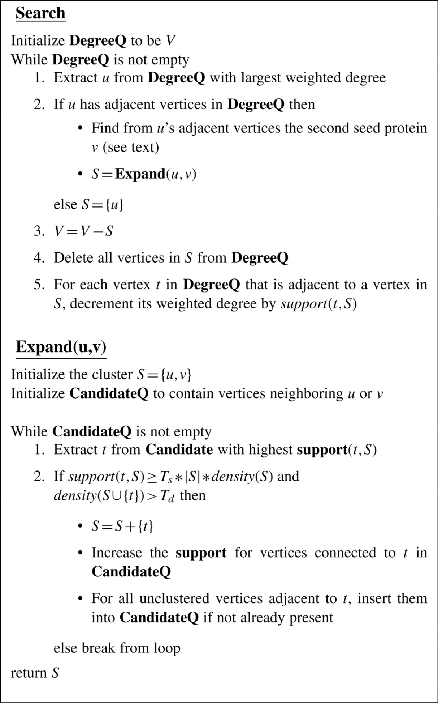
Jiang et al., SPICi: a fast clustering algorithm for large biological networks, 2010, Bioinformatics.
Notes:
Fig. 1. Example to illustrate the clustering process. This example network has 10 vertices, and every edge has confidence 1 except (1,6), (1,10), (5,6) and (7,8). Suppose the support threshold is T<sub>s</sub>=0.5. The highest weighted degree vertex, vertex 1 with weighted degree 4, is taken as a seed protein. The highest non-empty bin (0.8, 1] for vertex 1 is composed of neighboring vertices 2, 3 and 9. Of these, vertex 2 has weighted degree 3, the largest of this bin, and it is taken as the second seed vertex. In the first step of the density-based search, vertex 3 has the highest support, 2, from the current cluster {1, 2}. We add vertex 3 to the cluster and this cluster now has density 1. Then, all the remaining vertices have support less than density×cluster_size×Ts=1.5. Thus we stop expanding the cluster and output {1,2,3} as the first cluster. After this, the next search will start from vertex 6 and output {6,7,8} as the next cluster. Vertices 4, 5, 9 and 10 are left as singleton clusters.

Slide 9
Pipeline
Download Data
Gene expression Matrix
Breast Cancer Tissue
Normal Breast Tissue
Filter low expressed genes
(FPKM < 1)
Correlation Network Construction
Differential Network Analysis
Network Clustering
GO Enrichment Analysis (GREAT)
Notes:
Filter genes with FPKM less than 1
After filtering we get a total of 19K genes.
Genomic Regions Enrichment of Annotation Tool

Slide 10
Results- Network Properties
 | Cancer Networks |  | Normal Networks
 | Pearson | Spearman | Pearson | Spearman
Nodes | 14028 | 10805 | 13645 | 13261
Edges | 1063460 | 160839 | 4789094 | 5181969
Density | 0.0108091 | 0.002755 | 0.0514479 | 0.058939
Diameter | 14 | 17 | 11 | 12
Clustering Coefficient | 0.51142 | 0.35883 | 0.61422 | 0.605793
Shortest Path | 4.515 | 5.3717 | 3.2793 | 3.268
Differ Significantly with the random networks:-
Average path length (P-Value = 0.0004883) and clustering coefficient (P-Value=0.0009766)
https://igraph.org/r/
Notes:
Cancer network have more number of nodes.
Normal network is more dense as compared to cancer network and which is due to fact that many genes loss their functions after mutations.
Pearson Networks are more dense as compared to normal samples and also have more clustering coefficients.
Compared these networks random networks “Erdos-Renyi” model in iGraph

Slide 11
Pearson V/S Spearman Correlation
 | Cancer Networks |  | Normal Networks
 | Pearson | Spearman | Pearson | Spearman
Differential Nodes | 3748 | 525 | 517 | 133
% Differential Nodes | 26.71 % | 4.85 % | 3.79 % | 1.01 %
Differential Edges | 994862 | 92241 | 953814 | 1346689
% Differential Edges | 93.54 % | 57.34 % | 19.91 % | 25.98 %
Pearson correlation network is more dense and connected.
https://igraph.org/r/
Notes:
So for further analysis we used Pearson correlation network

Slide 12
Differential network analysis
 | Cancer Network | Normal Network
Total Nodes | 14028 | 13645
Differential Nodes | 2278 | 1895
% Differential Nodes | 16.21 % | 13.88 %
Total Edges | 1063460 | 4789094
Differential Edges | 928753 | 4654387
% Differential Edges | 87.33 % | 97.18 %
https://igraph.org/r/
Notes:
A edges are different.
The differential nodes didn’t enriched with significant GO terms.

Slide 13
GO enrichment of Breast cancer clusters
Cluster 4 have a total of 342 genes.
Enrichment of lot of immune terms.
The expression level of the genes is low in cancer samples.
Notes:
After Clustering with SPICI we got a total of 46 clusters in cancer and 41 clusters in normal sample.
That would mean that you have 3 times as many genes annotated with that term as you would expect given the size of your gene list and the number of genes annotated with that term in the genome.

Slide 14
The number of genes in Cluster 14 is 134.
It contains a lot of cell proliferation terms and cancer terms.

Slide 15
Conclusions
Pearson correlation did better than Spearman method for breast cancer dataset.
Differential network analysis shows that the interactions or co-expression of genes differ significantly in normal and cancer samples.
We found clusters enriched with terms related to breast cancer development and progression.
Notes:
Many papers also used Pearson in place of Spearman for gene expression profiles.
More dense networks in normal samples as compared to the cancer one.

Slide 16
Future Work
In-depth analysis of the modules of co-expression networks.
Gene Regulatory Networks using GENIE3 or ARCANE.
Detailed differential co-expression Network analysis using DICER or DiffCoEx.

Slide 17
Acknowledgment
Dr. Julie Dickerson
Dr. Iddo Friedberg

